Slide 1
Hypothesis on the occurrence of Stroke
Debasish
Subham
Sachin
Supriya

Slide 2
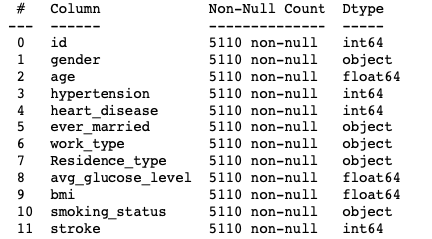
BASIC EXPLORATION OF THE DATASET
The dataset has 5110 rows , 12 columns.

Slide 3
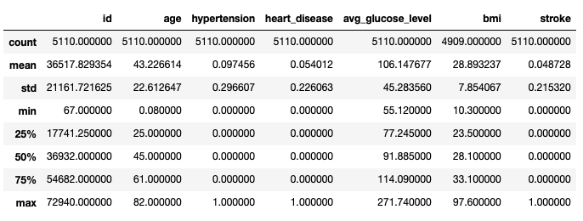
DESCRIPTIVE STATISTICS

Slide 4
Important Terminologies
Hypertension:
It is a long-term medical condition in which the blood pressure in the arteries is persistently elevated. Long-term high blood pressure, however, is a major risk factor for coronary artery disease, stroke, heart failure, etc.
Glucose level:
It is the concentration of glucose(simple sugar) present in the blood of humans and other animals.
BMI:
The BMI is a convenient rule used to broadly categorise a person as underweight, normal weight(18.5 to 25), overweight(25 to 30), or obese (over 30) based on tissue mass (muscle, fat, and bone) and height.
Stroke:
A stroke is a medical condition in which poor blood flow to the brain causes cell death.

Slide 5
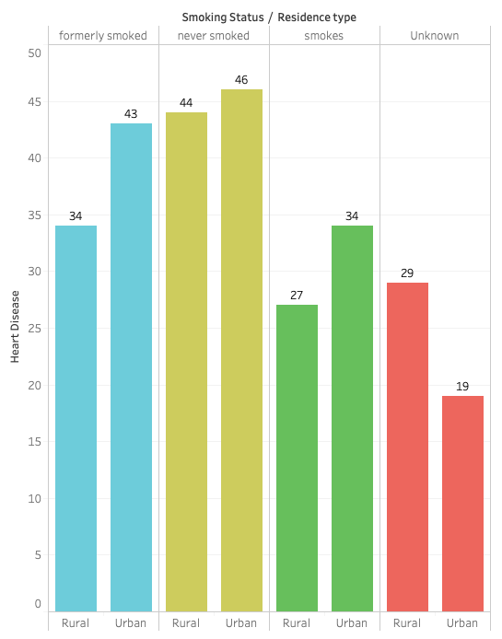
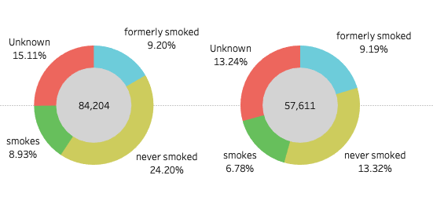
FUNDAMENTAL ANALYSIS
Male
Female

Slide 6
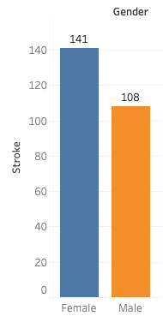
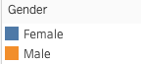
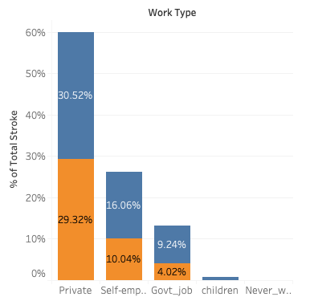
Cont….

Slide 7
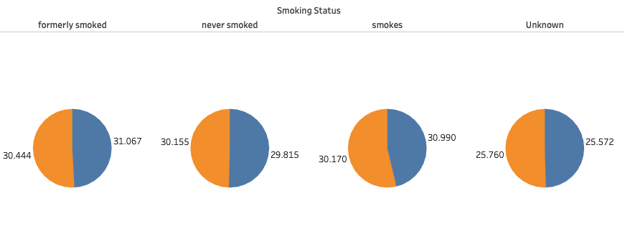
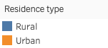
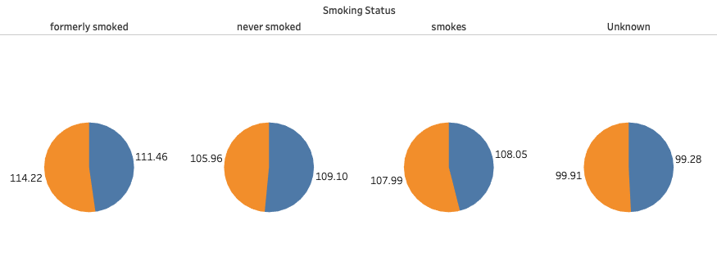
Cont…..
BMI
Avg Glucose Level

Slide 8
Hypothesis Testing
Chi2_square Contingency
Chi2_square Test
Mann–Whitney U Test
Kruskal-Wallis Test

Slide 9
Chi2_square Contingency
This function computes the chi-square statistic and p-value for the hypothesis test of independence of the observed frequencies in the contingency table.
#H0 : there is no association b/w smoking and stroke
#H1 : there is association b/w smoking and stroke
Conclusion:
P-value=9.50424061123842e-06. Since P-Value is close to 0 and less than alpha (0.05) we Reject H0. There is relation between Smoker and Stroke

Slide 10
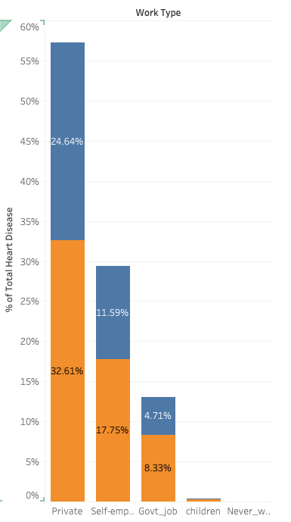
Chi2_square Test
Q. The survey claims that chances of heart_disease is 50% among private ,20% among self-employes, 18% among Govt-jobs and 12% among children.Check the surveys claim using p-value criteria. Consider a 5% level of significance.
H0 : According to chances of heart disease is 50% among private ,20% among self-employes,18% among Govt-jobs and 12% among children.
H1 : The ratio of Work type Dependency on Heart Disease used is different from the claimed Value.
Conclusion:
###### Conclusion:
P-value is less than 0.05 thus we can reject the null hypothesis at 5% level of significance and conclude that the ratio of Work type Dependency on Heart Disease used is different from the claimed Value.

Slide 11
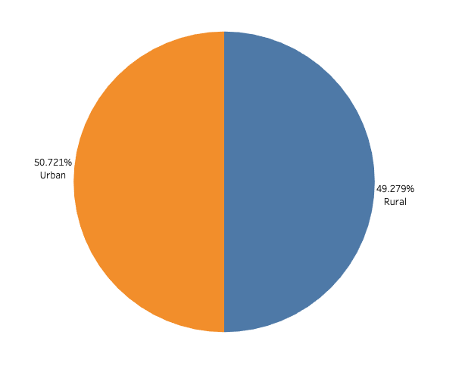
Mann–Whitney U Test
The Mann–Whitney U test is a nonparametric test of the null hypothesis that, for randomly selected values X and Y from two populations, the probability of X being greater than Y is equal to the probability of Y being greater than X.
A very general formulation is to assume that:
All the observations from both groups are independent of each other,
Under the null hypothesis H0, the distributions of both populations are equal.
The alternative hypothesis H1 is that the distributions are not equal
#### H0: Average BMI is same IN RESIDENT TYPE.
#### H1: Average BMI is not same IN RESIDENT TYPE.
Conclusion:
P-value=0.47477673713654733. Since P-Value is greater than alpha (0.05) we Accept H0. Average BMI is same IN RESIDENT TYPE.

Slide 12
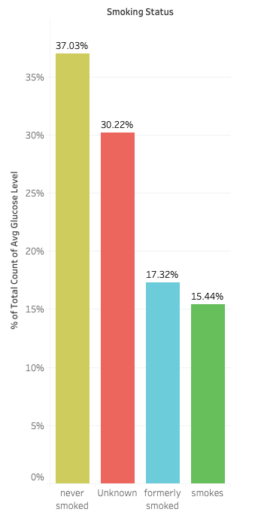
Kruskal-Wallis Test
The Kruskal Wallis test is the non-parametric alternative to the One Way ANOVA. Non-parametric means that the test doesn’t assume your data comes from a particular distribution. The H test is used when the assumptions for ANOVA aren’t met (like the assumption of normality). It is sometimes called the one-way ANOVA on ranks, as the ranks of the data values are used in the test rather than the actual data points.
The hypotheses for the test are:
#H0 : sample mean rank of the smoking status related to Average Glucose Level are same.
#H1: sample mean rank of the smoking status related to Average Glucose Level are not the same.

Slide 13
Central Limit Theorem
Central limit theorem (CLT) states that the distribution of sample approximates a normal distribution (also known as a “bell curve”) as the sample size becomes larger, assuming that all samples are identical in size, and regardless of the population distribution shape.

Slide 14
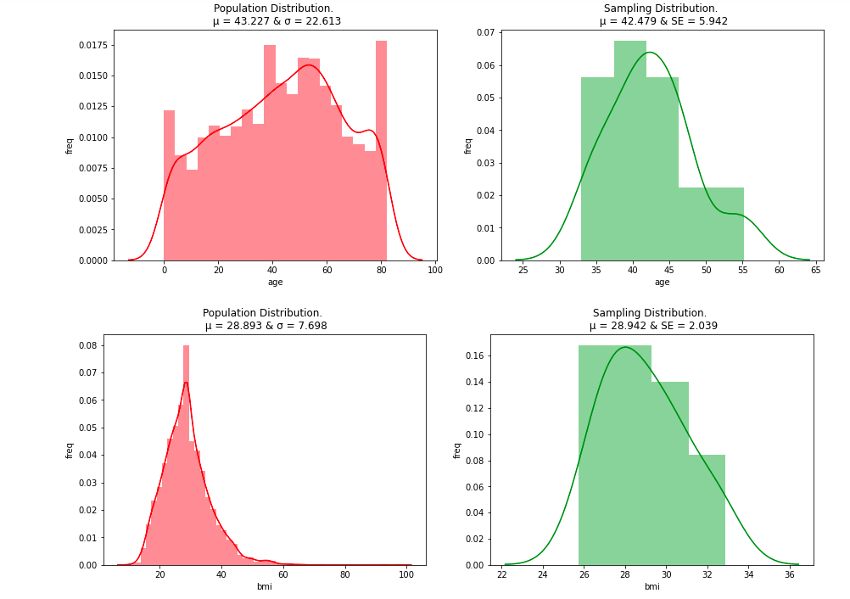
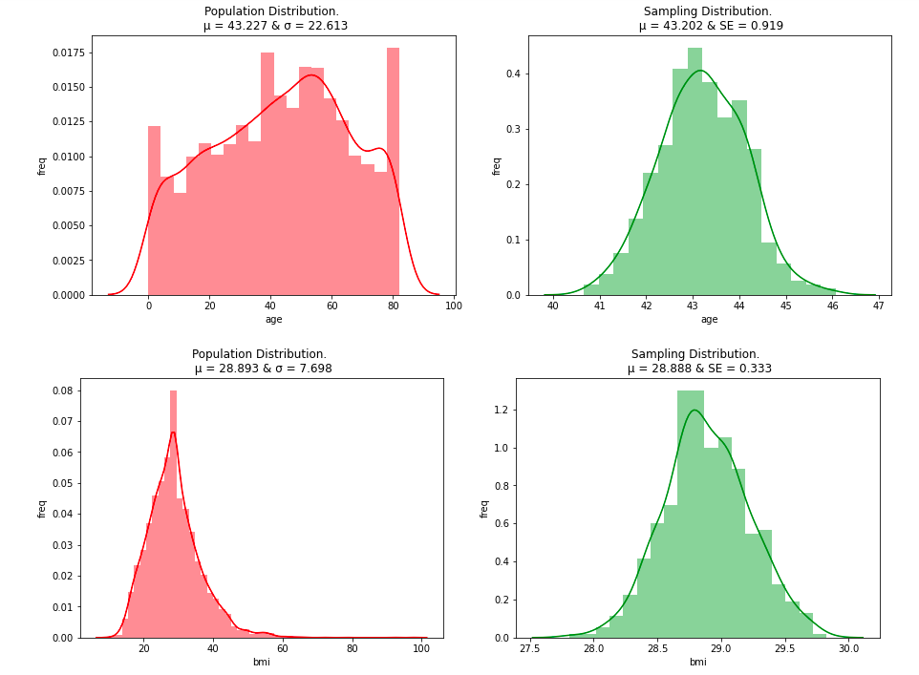
Sample size: 20
No. of Sample:20
Sample size: 500
No. Of Sample:500

Slide 15
THANK YOU :)

